Slide 1
Tutorial 1 Getting Started with HTML5

Slide 2
Working with Hypertext Links
Hypertext is created by enclosing content within a set of opening and closing <a> tags like:
<a href=“url”>content</a>
where url is Uniform Resource Locator (URL)
Inline images can also be turned into links by enclosing the image within opening and closing <a> tags
<a href=“ct_start.html”>
<img src=“ct_logo2.png” />
</a>

Slide 3
Linking to a Location within a Document
Mark location with the id attribute id=“text”
<h2 id="rules">Rules</h2>
Linking to an id
To link to a location within the current page
<a href="#rule">Read the Rules</a>
To link to a location within another page
<a href="file#id">content</a>

Slide 4
Linking to the Internet and Other Resources
Links to Web resources have a general structure like:
http://server/path/filename#id
where server/domain name is the name of the web server hosting the resource
path is the path to the file on that server
filename is the name of the file, and if necessary, id is the name of an id within a file
http://www.food.com/thai/docs/menus.html#lunch

Slide 5
Linking to the Internet and Other Resources
E-mail address can be turned into a hypertext link using the URL:
mailto : address
address is the email address
Example:
<a href="mailto:mbashir1@douglascollege.ca?Subject=Test">Contact your instructor</a>

Slide 6
Validating Your Website
https://validator.w3.org/

Slide 7
Tutorial 3 Designing a Web Page with CSS

Slide 8
Objectives
Explore the history and theory of CSS
Define a style rule
Study style precedence and inheritance
Apply color using CSS
Explore CSS3 color extensions
Use contextual selectors

Slide 9
Objectives
Work with attribute selectors
Apply text and font styles
Install a Web font
Define list styles
Use pseudo-classes and pseudo-elements
Create a rollover effect

Slide 10
Introducing CSS
The appearance of the page is determined by one or more style sheets written in the Cascading Style Sheets (CSS) language
The latest version of the CSS language is CSS3
CSS3 is built upon several modules, where each module is focused on a separate design topic

Slide 11
Types of Style Sheets
Browser styles or user agent styles – Styles built into the browser
User-defined styles – Styles defined by a user based on the configuration setting of the user’s browser
External styles – Styles created by a website author, placed within a CSS file, and linked to the page

Slide 12
Types of Style Sheets (continued)
Embedded styles – Styles added to the head of an HTML document
Inline styles – Styles added as element attributes within an HTML document and applied to only that particular element

Slide 13
Exploring Style Rules
The general syntax of a CSS style rule is
selector{
property1: value1;
property2: value2;
...
}
Example:
h1 { color : red;
text-align:center;
}

Slide 14
Embedded Style Sheets
They are inserted directly into the HTML file as metadata by adding the following element to the document head
<style>
style rules
</style>
where style rules are the different rules embedded in the HTML page
For example
<style>
h1{
color:red;
text-align: center;
}
</style>

Slide 15
Inline Styles
They are styles applied directly to specific elements using the following style attribute
<element style=“property1: value1;
property2: value2; …”>
content
</element>
where the property: value pairs define the styles applied directly to that element
<h3 style="color:aqua; text-align: center;">Third heading</h3>

Slide 16
Style Specificity and Precedence
The more specific style rule has precedence over the more general style rule
Specificity is an issue when two or more styles conflict
If two rules have equal specificity and equal importance, then the one that is defined last has precedence

Slide 17
Style Inheritance
Style inheritance – Process in which properties are passed from a parent element to its children
For example, the following style rule sets the color of article text to blue and the rule is passed to any paragraph or other elements nested within that article
article {color: blue;}

Slide 18
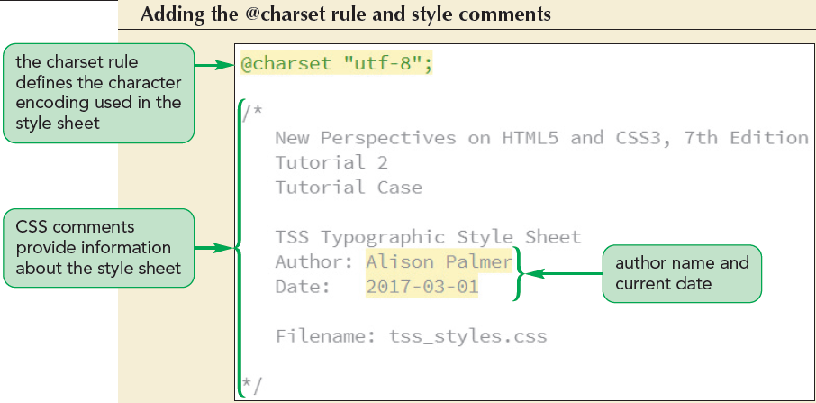
Writing Style Comments

Slide 19
Importing Style Sheets
@import is a CSS at-rule used to import the content of a style sheet file
@import url(url);
where url is the URL of an external stylesheet file
It is similar to adding link elements to an HTML file

Slide 20
Working with Color in CSS
Color values – Values in which the color is given by an exact numeric representation.
RGB values and HSL values
RGB triplet – The intensity of primary colors expressed as a set of numbers in CSS
rgb(red, green, blue) – e.g rdb(255,255,0)
Hexadecimal numbers – A number expressed in the base 16 numbering system
#redgreenblue – e.g.#FFFF00
rgb(100%, 65%, 0%)

Slide 21
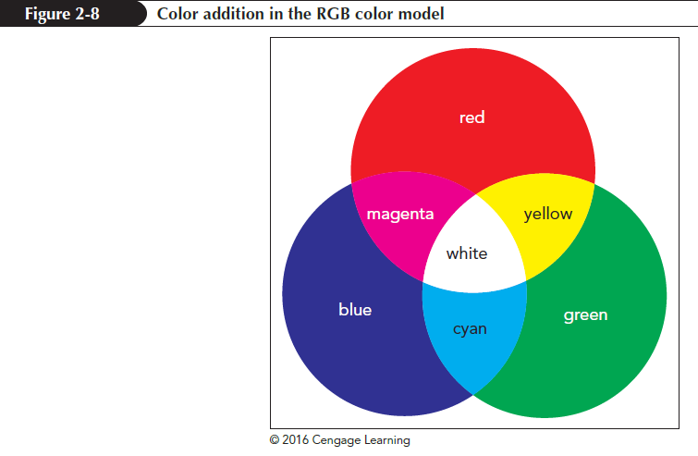
RGB Color Values

Slide 22
HSL Color Values
Hue – Tint of a color, represented by a direction on a color wheel
Saturation – Measures the intensity of a color and ranges from 0% (no color) up to 100% (full color)
Lightness – Measures the brightness of a color and ranges from 0% (black) up to 100% (white)
hsl (hue, saturation, lightness)
Medium orange → hsl (38,90%,60%)

Slide 23
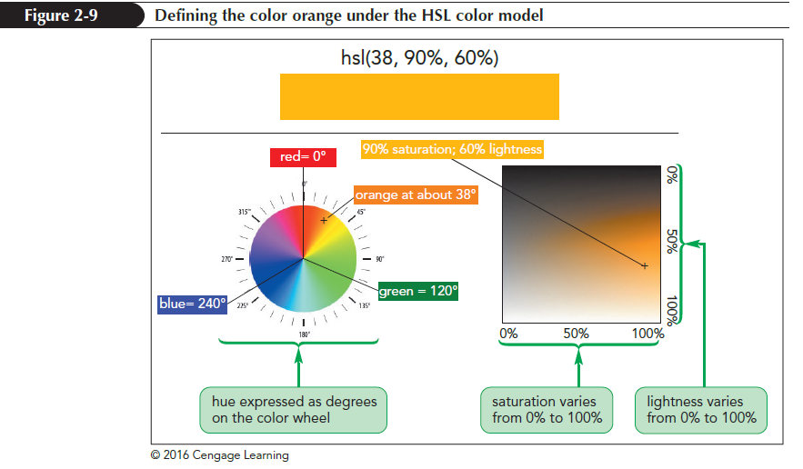
HSL Color Values (continued)

Slide 24
Defining Semi-Opaque Colors
Opacity – Defines how solid a color appears
A color’s opacity is specified using the following properties:
rgba(red, green, blue, opacity)
hsla(hue, saturation, lightness, opacity)
where opacity sets the opacity of the color ranging from 0 (completely transparent) up to 1.0 (completely opaque)

Slide 25
Setting Text and Background Color
CSS defines the text and background color for each element on a webpage
color: color;
background-color: color;
where color is a color name or a color value

Slide 26
Selector Patterns Contextual Selectors
Selector patterns - are use to direct a style rule to specific elements
Contextual selector – Specifies the context under which a particular page element is matched
Context is based on the hierarchical structure of a document, which involves the relationships between a parent element containing one or more child elements and within those child elements several levels of descendant elements
Parent descendant {styles}

Slide 27
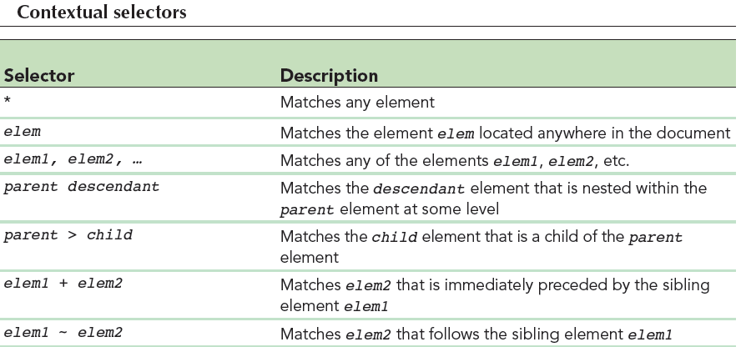
Contextual Selectors (continued 1)

Slide 28
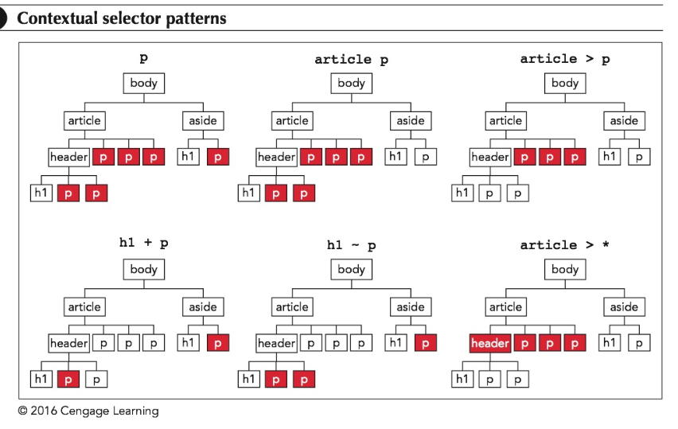
Contextual Selectors (continued 2)

Slide 29
Contextual Selectors (continued 3)
To match any element, a wildcard selector with the * character is used
article > * { color : blue; }
Sibling selectors are used to select elements based on elements that are adjacent to them in the document hierarchy
h1+ h2 { color : blue; } → select h2 only if it is immediately preceded by an h1 element
h1~ h2 { color : blue; } → select any h2 element that is preceded (not necessarily immediately) by h1

Slide 30
Attribute Selectors
Selectors also can be defined based on attributes and attribute values within elements
id – Identifies specific elements within the document
#id or elem#id e.g. #title or h1#title
class– Identifies a group of elements that share a similar characteristic or property
elem.class
e.g. h1.intro { color: blue; } or .intro { color: blue; }

Slide 31
Working with Fonts
Typography is the art of designing the appearance of characters and letters on a page
Color and font are one of few properties in the CSS family of typographical styles

Slide 32
Choosing a Font
Text characters are based on fonts that define the style and appearance of each character in the alphabet
The general structure of defining font for any page element is
font-family: fonts;
where fonts is a comma-separated list,
also known as a font stack

Slide 33
Choosing a Font (continued)
Specific font – Identified by name and based on a font definition file stored in a user’s computer or accessible on the web
Generic font – Describes the general appearance of the characters in the text but does not specify any particular font definition file
CSS supports the font groups serif, sans-serif, monospace, cursive, and fantasy

Slide 34
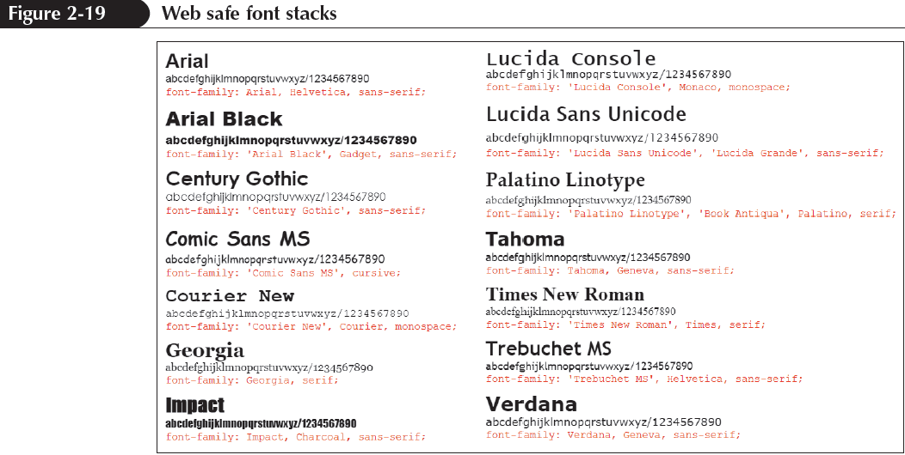
Styling Web Page Text

Slide 35
Setting the Font Size
To set a font size, use the font-size property
font-size: size;
where size is a CSS unit of length in either relative or absolute units.
Absolute units – Fixed in size regardless of the output device and are used only with printed media. Five units mm, cm, in(inches), pt(points) and pc(picas)
Relative units – Expressed relative to the size of other objects within the web page or to the display properties of the device itself. The basic unit is pixel(px)

Slide 36
Scaling Fonts with ems and rems
Text is made scalable with all font sizes expressed relative to default font sizes
The three relative measurements used to provide scalability are
Percentage – h1 { font-size: 200%}
em unit – h1{font-size: 2em}
rem or root em unit – h1{font-size: 1rem;}

Slide 37
Sizing Keywords
Font sizes are expressed using the following keywords
xx-small
x-small
small
medium
large
x-large
xx-large
larger
smaller

Slide 38
Controlling Spacing and Indentation
Kerning measures the amount of space between characters, while tracking measures the amount of space between words
The properties to control an element’s kerning and tracking are:
letter-spacing: value;
word-spacing: value;

Slide 39
Controlling Spacing and Indentation (continued 1)
Leading – Measures the amount of space between lines of text and is set using the following line-height property:
line-height: size;
Text spacing can be controlled by setting the indentation for the first line of text block by using the text-indent property
text-indent: size;

Slide 40
Working with Font Styles
To specify the font style, use
font-style: type;
where type is normal, italic, or oblique
To change the weight of the font, use
font-weight: weight;
where weight is the level of bold formatting applied to the text could be bold or normal

Slide 41
Working with Font Styles (continued 1)
To specify a text decoration, use
text-decoration: type;
where type is none, underline, overline, or line-through
To transform text, use
text-transform: type;
where type is capitalize, uppercase, lowercase, or none

Slide 42
Working with Font Styles (continued 2)
To display a font variant of text, use
font-variant: type;
where type is normal or small-caps

Slide 43
Aligning Text Horizontally and Vertically
To horizontally align the text , use
text-align: alignment;
where alignment is left, right, center, or justify
To vertically align the text within each line, use
vertical-align: alignment;
where alignment is baseline, bottom, middle, sub, super, text-bottom, text-top, or top

Slide 44
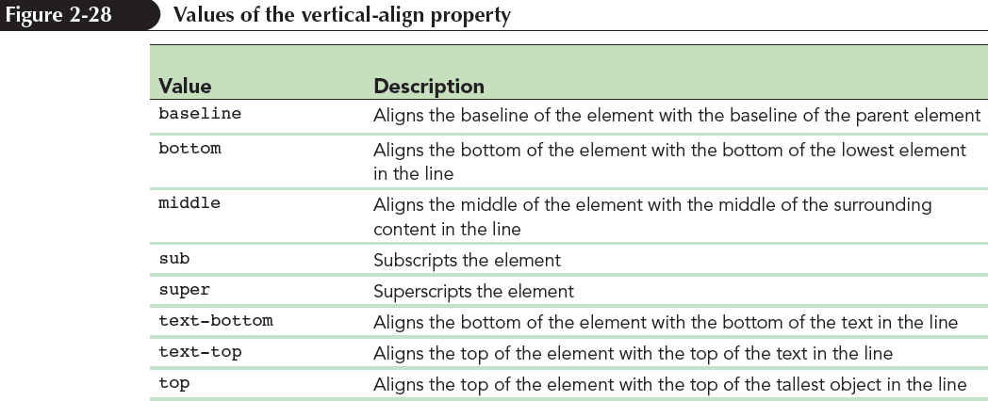
Aligning Text Horizontally and Vertically (continued)

Slide 45
Combining All Text Formatting in a Single Style
The text and font styles can be combined using the following shorthand font property:
font: style variant weight size/height family;
where style is the font’s style, variant is the font variant, weight is the font weight, size is the font size, height is the height of each line, and family is the font stack

Slide 46
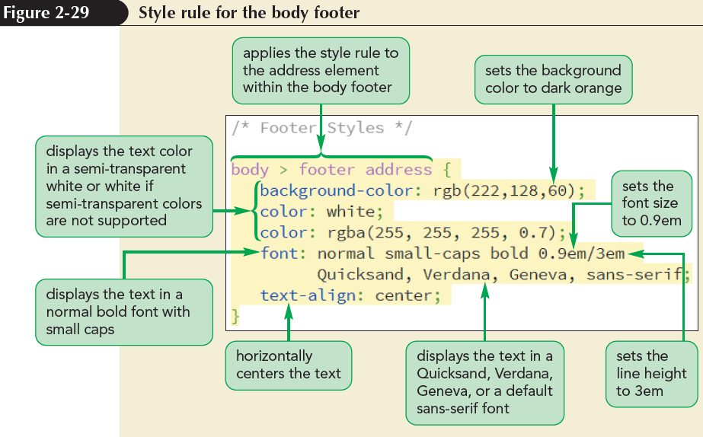
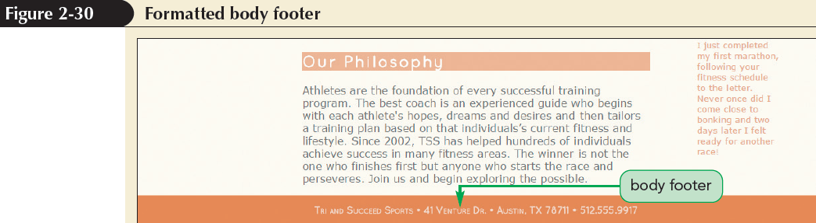
Combining All Text Formatting in a Single Style (continued)

